Slide 1
Q&A
RESPIRATORY SYSTEM

Slide 2
Q & A
1. A 76-year-old man has experienced increasing dyspnea for the past 4 years. On physical examination, he is afebrile, with a pulse of 70/min, respirations 30/min, and blood pressure 120/75 mm Hg. A chest radiograph shows increased interstitial markings, but no effusions. The right heart border and the pulmonary arteries are prominent. A transbronchial biopsy is performed; the figure shows the microscopic appearance with Prussian blue stain. Which of the following is the most likely diagnosis?
A Anthracosis
B Asbestosis
C Berylliosis
D Calcinosis
E Silicosis

Slide 3
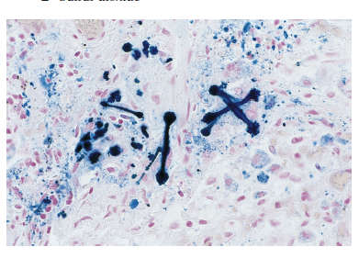

Slide 4
Q
2. A 36-year-old woman has had a low-grade fever and worsening nonproductive cough and dyspnea for the past 2 years. On examination, she has breath sounds in all lung fields. A chest CT scan shows the findings in the figure. An arterial blood gas shows pH, 7.45; Po2, 83 mm Hg; Pco2, 30 mm Hg; and HCO3–, 19 mEq/L. Pulmonary function tests show total lung capacity 3 L (60% of predicted), FEV1 2.5 (66% of predicted), and DLCO 10 mL/min/mm Hg (50% of predicted). Her pulmonary compliance is reduced. What is the most likely diagnosis?
A α1-Antitrypsin deficiency
B Chronic bronchitis
C Diffuse alveolar damage
D Goodpasture syndrome
E Nonatopic asthma
F Sarcoidosis

Slide 5
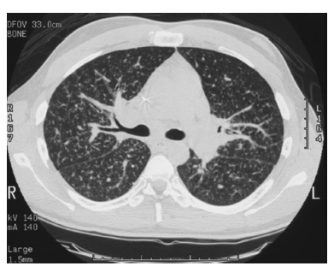

Slide 6
Q
3. A 33-year-old woman has had increasing dyspnea with cough for the past 10 days. Over the past 2 days, her cough has become productive of chunks of gelatinous sputum. On physical examination, she is afebrile. There is extensive dullness to percussion over all lung fields. A chest radiograph shows diffuse opacification bilaterally. A transbronchial biopsy is performed and the microscopic appearance with H&E staining is shown in the figure. On electron microscopy, there are many lamellar bodies. Antibody directed against which of the following substances is most likely to cause her illness?
A α1-Antitrypsin
B Chloride channel protein
C DNA topoisomerase I
D Glomerular basement membrane
E GM-CSF
F Neutrophilic myeloperoxidase

Slide 7
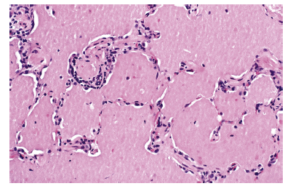

Slide 8
A
F Neutrophilic myeloperoxidase
The acquired form of pulmonary alveolar proteinosis (PAP) is an uncommon condition of unknown etiology characterized by autoantibodies against granulocyte-macrophage colony-stimulating factor (GM-CSF).
Ten percent of PAP cases are congenital secondary to mutations in the GM-CSF gene.
Both forms of PAP have impaired surfactant clearance by alveolar macrophages, leading to accumulation of a gelatinous alveolar exudate.
α1-Antitrypsin deficiency leads to panlobular emphysema with hyperlucent lungs on radiographs.
CFTR gene mutations lead to cystic fibrosis and widespread bronchiectasis.
Anti–DNA topoisomerase I antibodies are seen in diffuse scleroderma, which produces pulmonary interstitial fibrosis.
Anti–glomerular basement membrane antibody is present in Goodpasture syndrome with extensive alveolar hemorrhage.
Neutrophilic myeloperoxidase is a form of anti– neutrophil cytoplasmic autoantibody seen in ANCA-associated vasculitis

Slide 9
Q
4. A 68-year-old man has had worsening dyspnea with a nonproductive cough for the past 9 months. On physical examination, he is afebrile and normotensive. On auscultation of the chest, diffuse dry crackles are heard in all lung fields. A chest radiograph shows irregular opacifications throughout both lungs. A transbronchial biopsy is obtained and the microscopic findings with trichrome stain are shown in the figure. Laboratory studies include negative serologic tests for ANA, anti–DNA topoisomerase I, ANCA, and anticentromere antibody. Despite glucocorticoid therapy, his condition does not improve, and he dies 2 years later. What is the most likely diagnosis?
A Goodpasture syndrome
B Hypersensitivity pneumonitis
C Idiopathic pulmonary fibrosis
D Sarcoidosis
E Systemic sclerosis

Slide 10
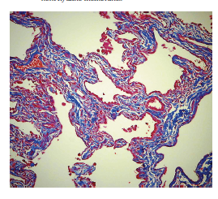

Slide 11
Q
5. A 33-year-old man has had increasing dyspnea for the past 8 years. He does not smoke. On examination, there are decreased breath sounds over lower lung fields. A chest radiograph shows flattened diaphragms; his CT scan is shown in the figure. Pulmonary function tests show decreased DLCO, decreased FEV1, and increased FVC. Arterial blood gas analysis shows Po2, 65 mm Hg; Pco2, 60 mm Hg; HCO3–, 32 mEq/L; and pH, 7.35. A sibling is similarly affected. What is the most likely mechanism for his pulmonary disease?
A Atopy with IgE binding to mast cells
B CFTR gene mutation
C Increased neutrophil proteases
D Prior infection with tuberculosis
E Reduced antielastase activity

Slide 12
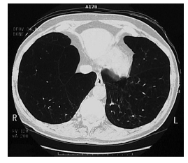

Slide 13
Q
6. A 58-year-old man with ischemic heart disease undergoes coronary artery bypass graft surgery under general anesthesia. Two days postoperatively, he experiences increasing respiratory difficulty with decreasing arterial oxygen saturation. On physical examination, his heart rate is regular at 78/min, respirations are 25/min, and blood pressure is 135/85 mm Hg. The hemoglobin concentration has remained unchanged, at 13.7 g/dL, since surgery. After he coughs up a large amount of mucoid sputum, his condition improves. Which of the following types of atelectasis does he most likely have?
A Compression
B Contraction
C Micro
D Relaxation
E Resorption

Slide 14
Q
7. 24-year-old primigravida has a fetal ultrasound performed at 18 weeks’ gestation that shows a normal amniotic fluid index, but there is a large echogenic region in the right lung. A term infant is delivered with no apparent external anomalies, but soon after birth the infant has respiratory distress. CT imaging shows a normal left lung, but there is an area of opacification in the right lung supplied by a vessel from the aorta. Which of the following is the most likely diagnosis?
A Extralobar sequestration
B Foregut cyst
C Hyaline membrane disease
D Oligohydramnios sequence
E Tracheoesophageal fistula

Slide 15
Q
8. A 30-year-old man is hospitalized after a motor vehicle accident in which he sustains blunt trauma to his chest. On physical examination, there are contusions to the right side of the chest, but no lacerations. Within 1 hour after the accident, he develops sudden difficulty breathing and marked pain on the right side. Vital signs now show that he is afebrile; his pulse is 80/min, respirations are 30/min and shallow, and blood pressure is 100/65 mm Hg. Breath sounds are not audible, and there is tympany to percussion on the right side. Which of the following radiographic findings for this man is shown in the figure?
A Interstitial fibrosis
B Patchy infiltrates
C Pleural effusion
D Pneumothorax
E Ventilation/perfusion mismatch

Slide 16
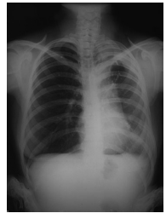

Slide 17
Q
KVEIM Test is done for which disease?

Slide 18
A
Sarcoidosis.

Slide 19
THANK YOU.

